Slide 1
Income Source and Income Change Variables
Preliminary Analysis Needs Assessment & Targeting Unit at WFP APP HQ

Slide 2
Introduction
The income source and income change variables have been used specifically since COVID-19 in WFP as a proxy indicator representing the economic vulnerability in current coping capacity of CARI.
This presentation explains the current way how the module has been implemented and examines the relationship between the income and other food security indicators using data collected in Myanmar, Ecuador and Central African Republic (CAR).

Slide 3

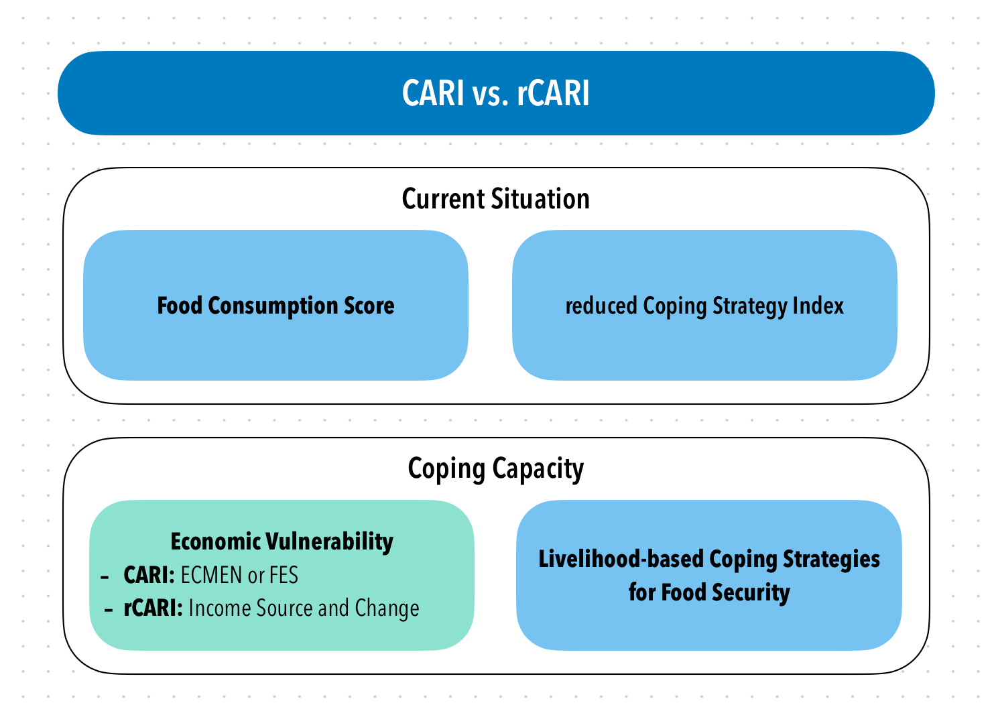
rCARI Validation Study
CARI and rCARI (remote CARI) aggregate indicators in a similar way and the only difference is in the Economic Vulnerability
To date, rCARI is not validated
Notes:
Consolidate Approach for Reporting food Insecurity (CARI)
rCARI useful in emergencies where F2F survey is not feasible
rCARI though easily available, results are not globally accepted because methodology is not been empirically validated against other standard methods- CARI
rCARI is based on the following modules
Food consumption score
Consumption-based coping strategy (rCSI)
Livelihood coping strategy (usually a shorter version of the original)
Income sources & income changes

Slide 4
Variable | Questions in Income Module | Choice List
HHHOccupation | What is the occupation of the household head? | Open Ended
HHInc_PCT | How many household members are contributing to the household income? | Number
HHIncNb | How many income sources does your household have? | Number
HHIncFirst | Main source of income for the household.](Hint: This is the most stable income source for the household)Relevance: HHIncNb > 0 | 1 Wage Labor – Professional 2 Wage Labor – Skilled 3 Wage Labor - Unskilled/Casual/Agriculture 4 Wage Labor - Unskilled/Casual/non-agriculture 5 Pension 6 Remittances 7 Aid/gifts 8 Borrowing money/Living off debt 9 High risk activity (e.g. begging, scavenging) 10 Saving/selling assets 11 Petty trade/selling on streets 12 Small trade (own business) 13 Medium/large trade (own business) 14 Small Agriculture production including livestock (own land/livestock) 15 Medium/large agriculture production including livestock (own land/livestock) 999 Other (specify)
HHIncFirst_Oth | SpecifyRelevance: HHIncFirst_SRi = ‘999’
HHIncChg | Was there a change in income over the last year? (Please do not consider currency devaluation.) | 0 No change 1 Increased 2 Reduced by less than 25% 3 Reduced by more than 25% and less than 50% 4 Reduced by more than 50%

Slide 5
Sample Completion
 | Country
 | Myanmar | Ecuador | CAR | Total
N | 1,665 (27.2%) | 2,372 (38.8%) | 2,080 (34.0%) | 6,117 (100.0%)
Survey Progress
Not Completed | 572 (34.4%) | 956 (40.3%) | 835 (40.1%) | 2,363 (38.6%)
Completed | 1,093 (65.6%) | 1,416 (59.7%) | 1,245 (59.9%) | 3,754 (61.4%)
Survey Modality
Face-to-Face | 610 (55.8%) | 760 (53.7%) | 969 (77.8%) | 2,339 (62.3%)
Remote | 483 (44.2%) | 656 (46.3%) | 276 (22.2%) | 1,415 (37.7%)
Source: rCARI survey 2023; For CAR, the current analysis is limited to phone owners only.

Slide 6
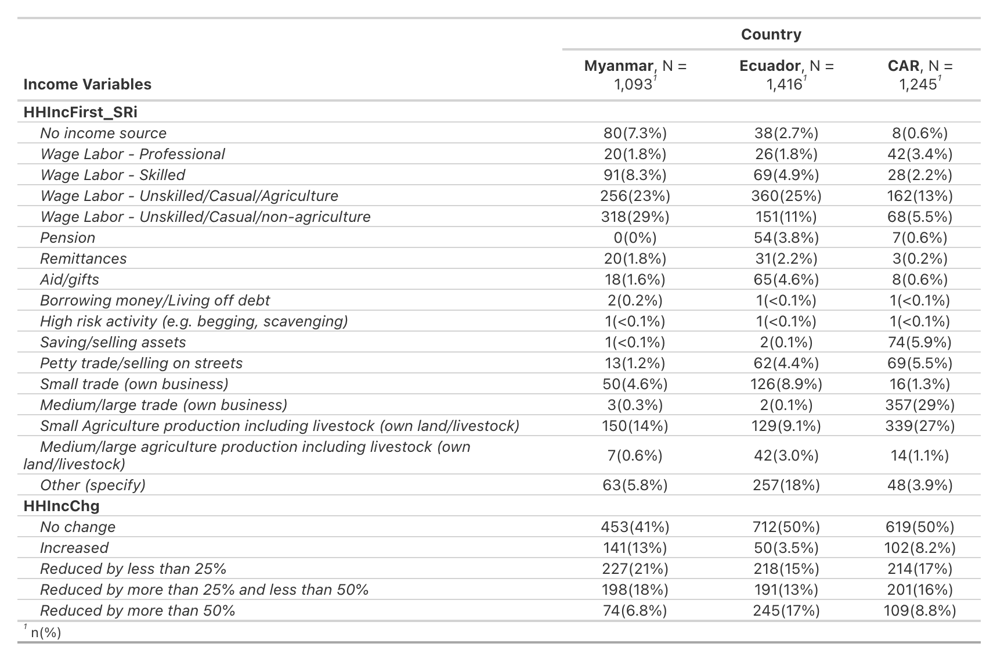
Overall Distribution by Country
Note: The other specify answers in income source variable (HHIncFirst_SRi) are not fully cleaned in tables below since many of them have limited information. Thus, they are not able to be recoded into the detailed source categories.

Slide 7
Current Categorization of Income Sources and Change
Income Sources:
Regular employment/income
Wage Labor – Professional/skilled
Pension
Small/Medium/large trade (own business)
Small/Medium/Large agriculture production including livestock (own or rented land/owned livestock)
Irregular employment/income
Wage Labor - Unskilled/casual/agriculture/unskilled/casual/non-agriculture
Remittances
Petty trade/selling on streets
No income
Aid/gifts
Borrowing money/Living off debt
High risk activity (e.g. begging, scavenging)
Saving/selling assets
No income source noted in HHIncNb
Income change is categorized as increased, reduced and no change.

Slide 8
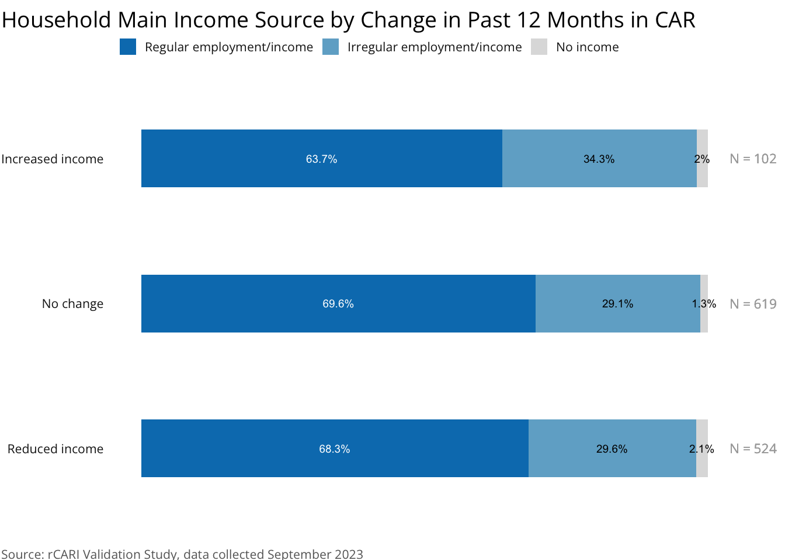
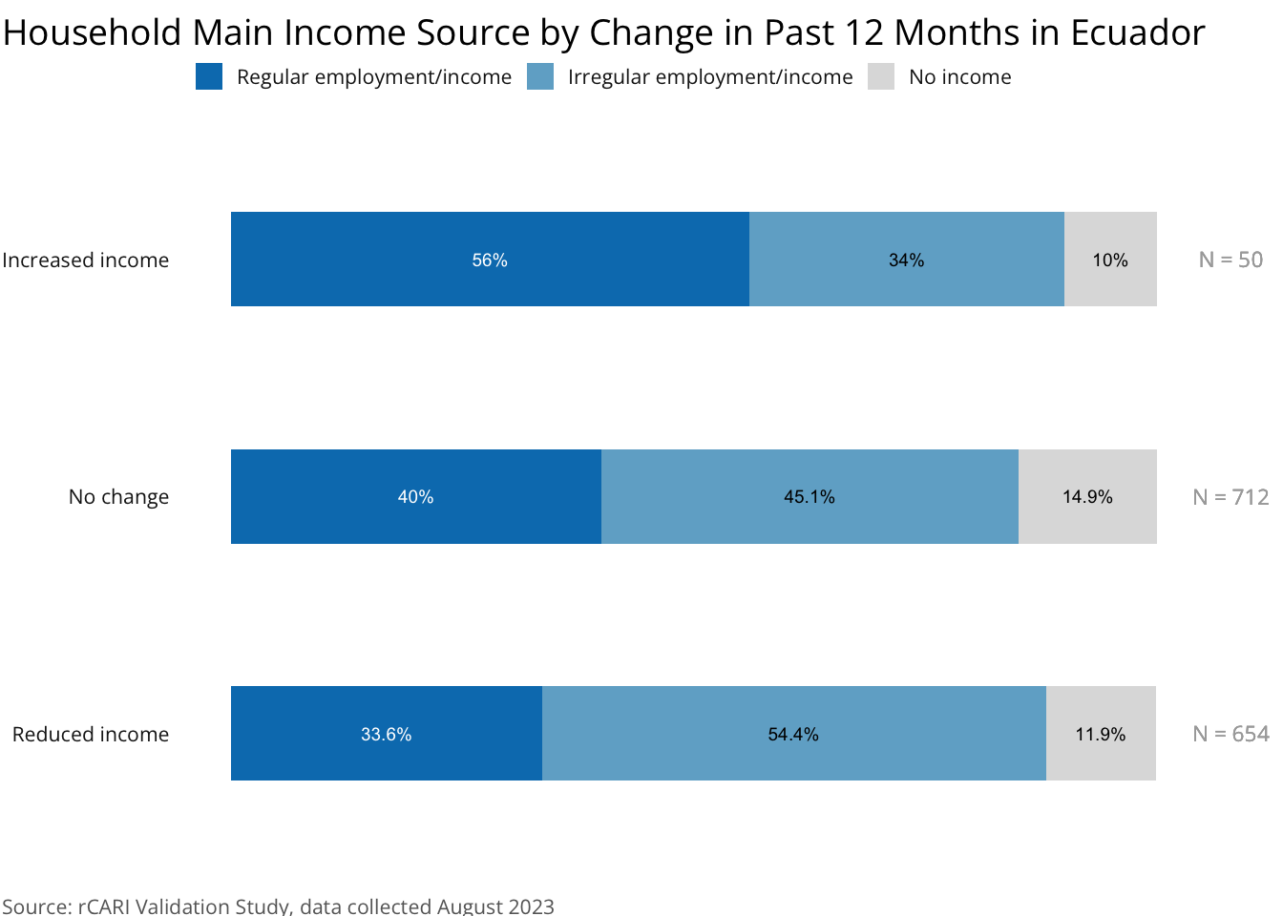
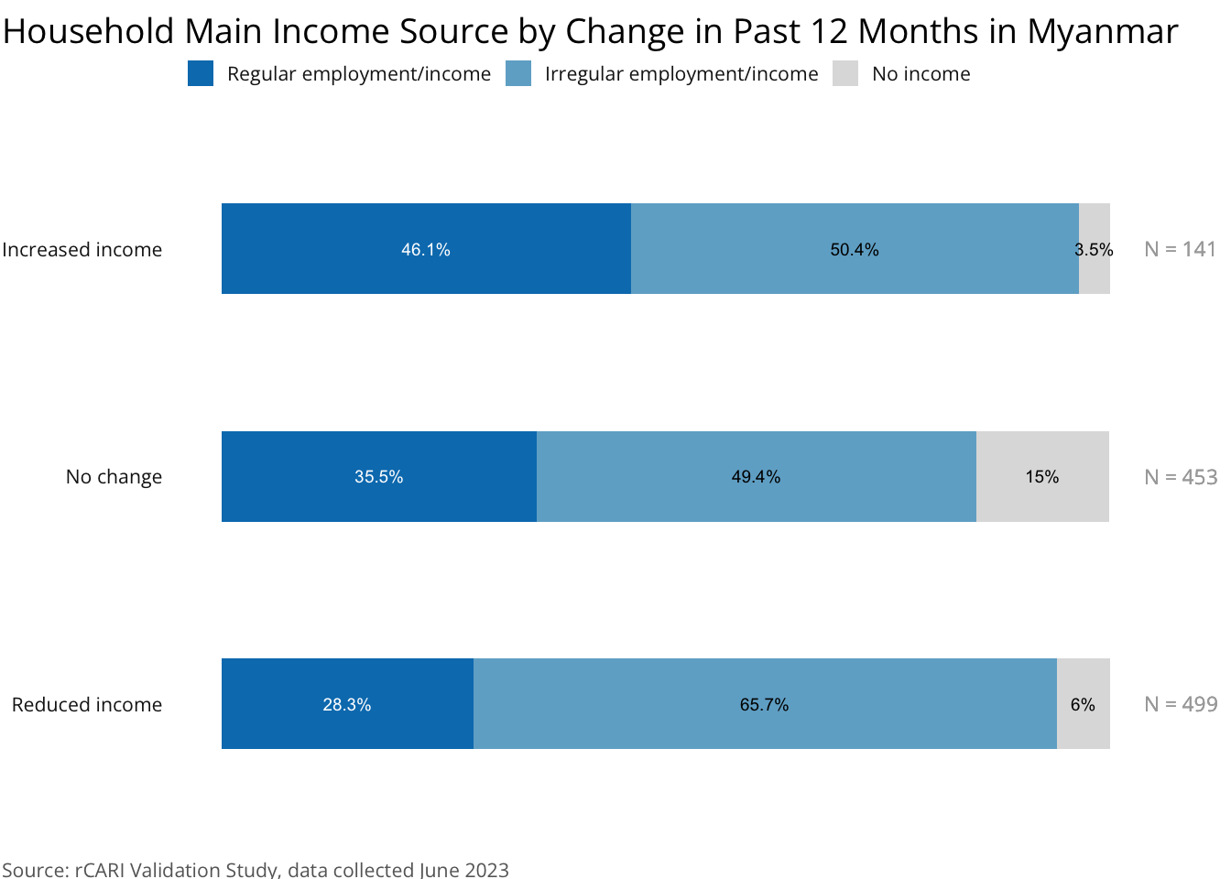

Slide 9
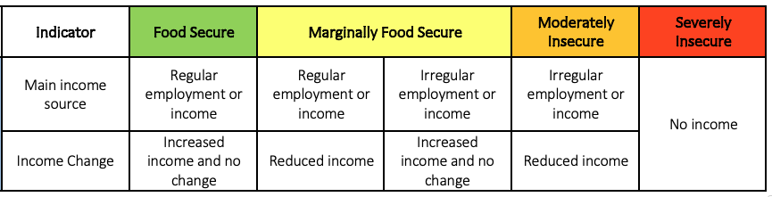
Aggregated Income Indicator
The combination of main income sources and changes over the past 12 months further aggregates to an overall 4-point income indicator

Slide 10
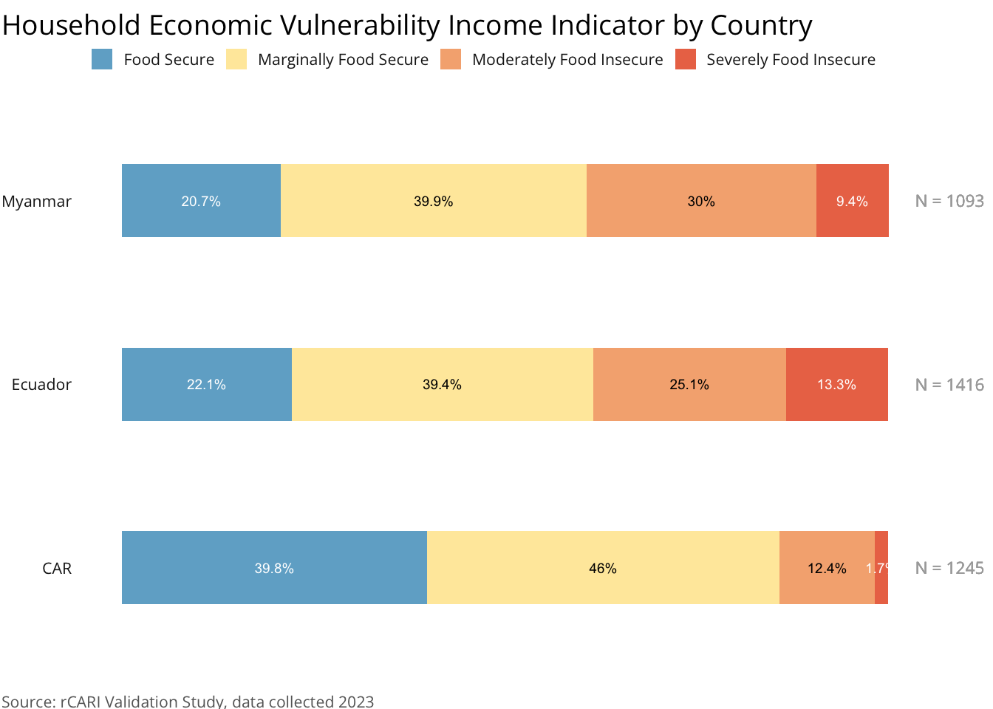

Slide 11
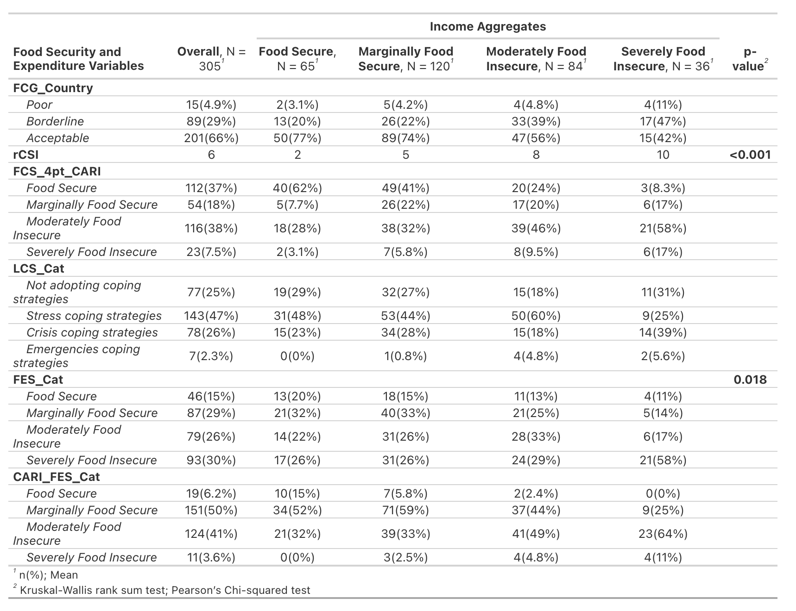
Correlation with FS indicators and Expenditure - Myanmar
Note: Only sample used standard expenditure module is included
Notes:
Missing p-value due to small sample size for valid statistical tests

Slide 12
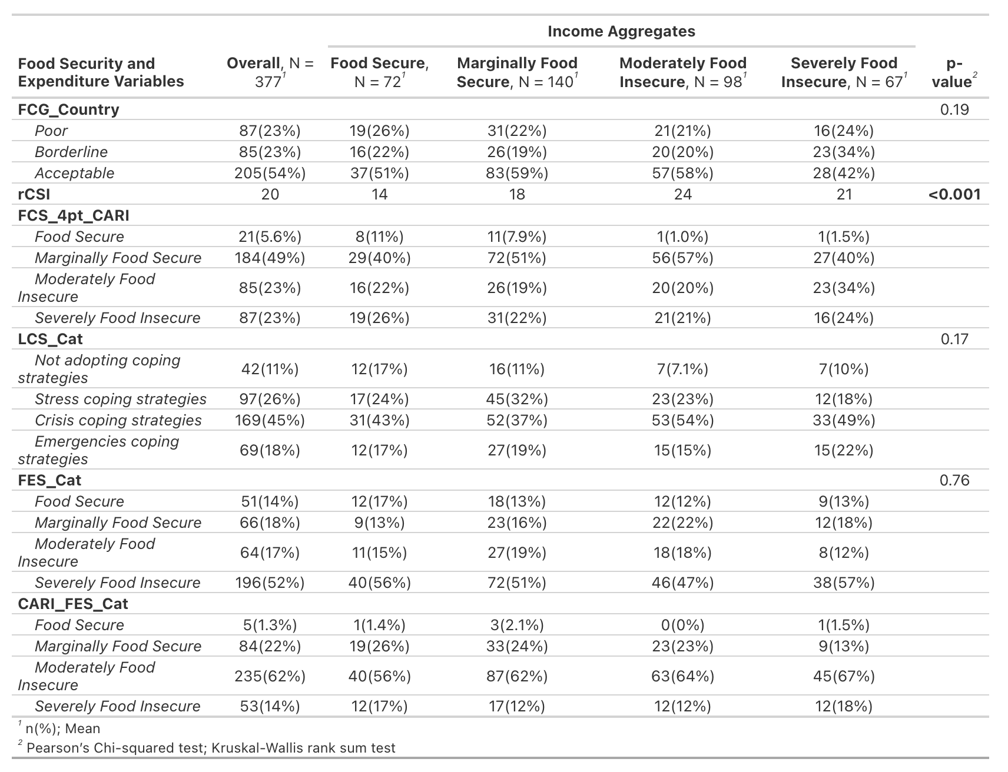
Correlation with FS indicators and Expenditure - Ecuador
Note: Only sample used standard expenditure module is included
Notes:
Missing p-value due to small sample size for valid statistical tests

Slide 13
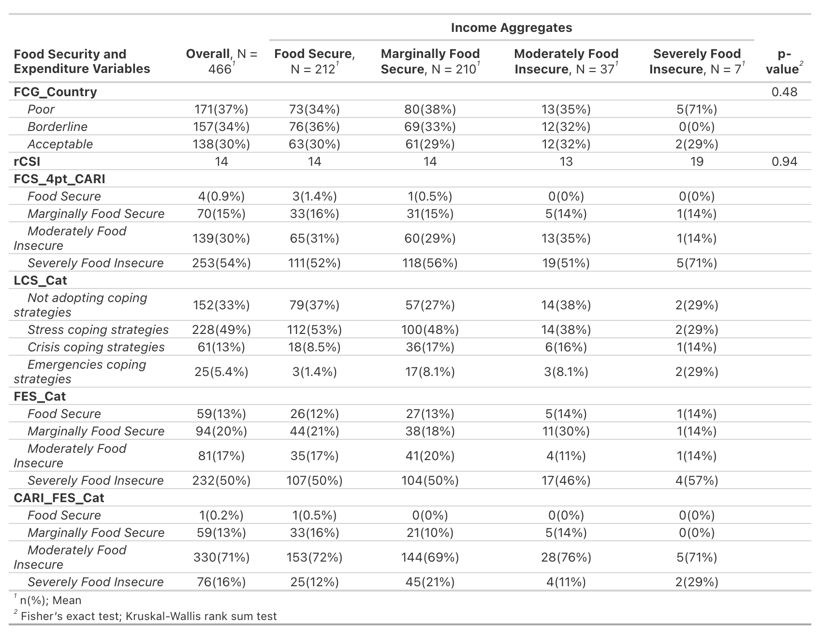
Correlation with FS indicators and Expenditure - CAR
Note: Only sample used standard expenditure module is included
Notes:
Missing p-value due to small sample size for valid statistical tests

Slide 14
Current progress

Slide 15
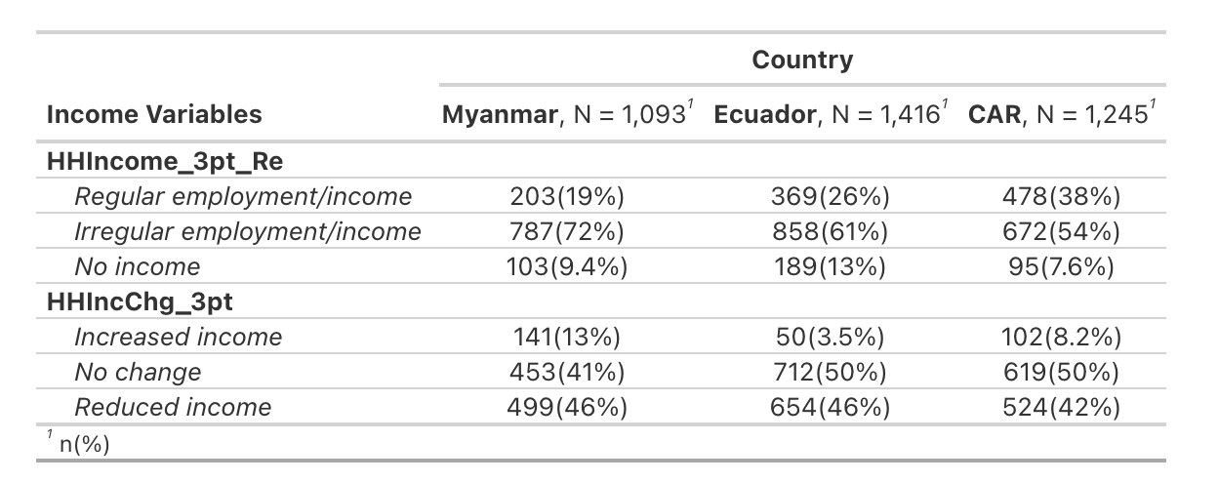
Recategorization of Smallholder Farmers
The income source and income change indicators in its current form seems to be showing some downward bias because of possible misclassification of low-income earners such as small-scale farmers and small enterprise owners in the 4-point scale into food secure.
The changes to the previous analysis after re-categorizing the small-scale farmers and small enterprise owners to Irregular Income Group are presented as below:

Slide 16
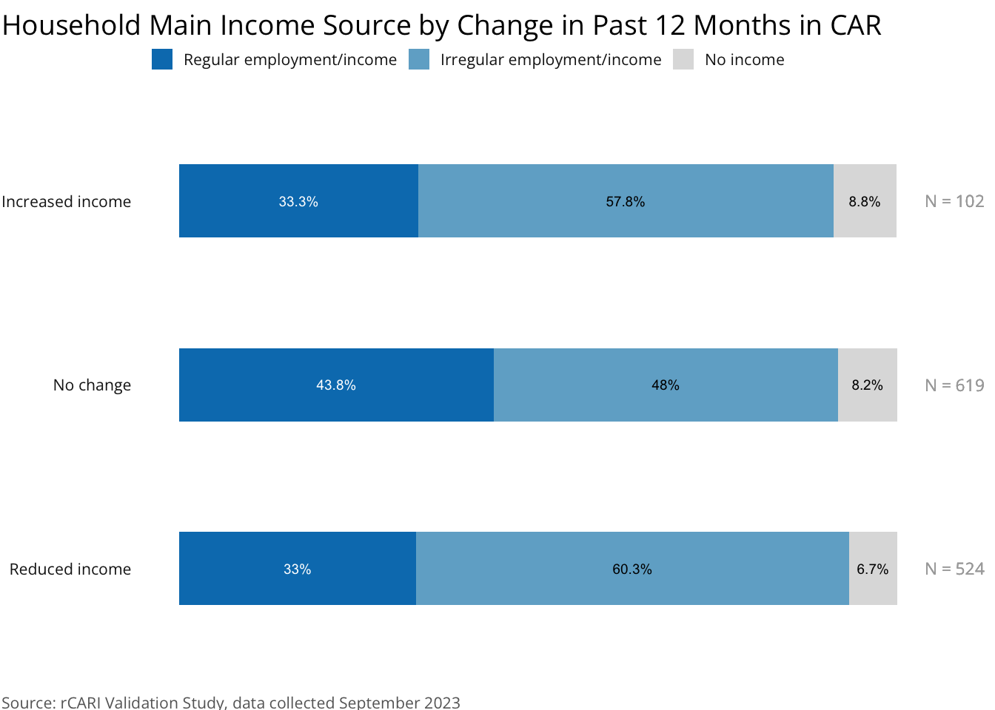
Before vs. After Recategorization - CAR
Before
After
Note: The other specify answers in income source variable (HHIncFirst_SRi) are fully cleaned in the aggregated 3pt category.

Slide 17
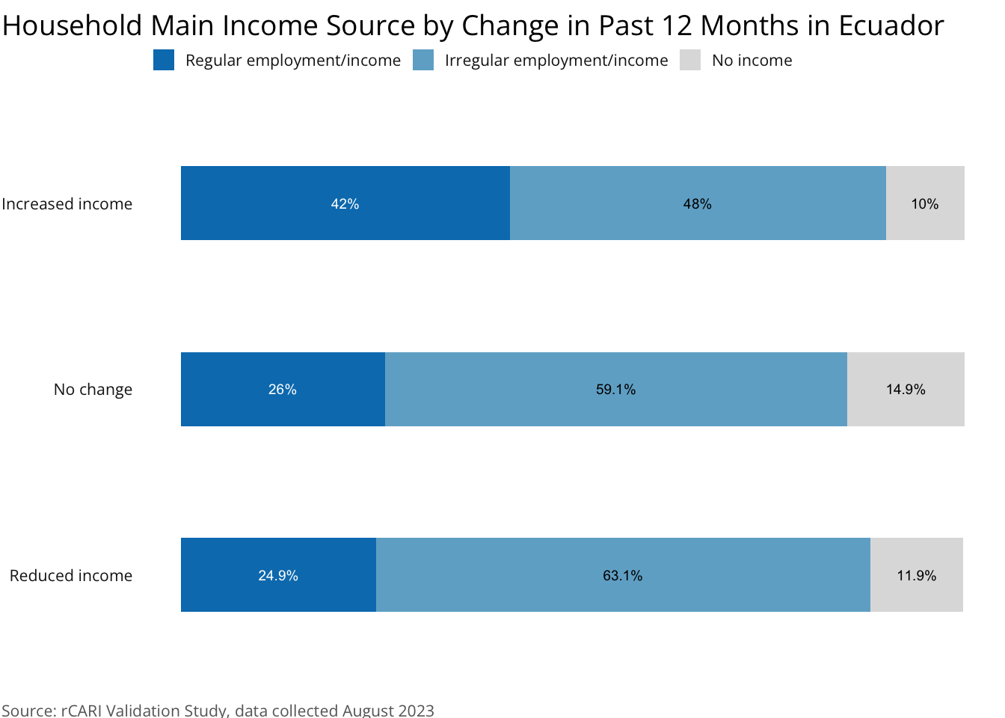
Before vs. After Recategorization - Ecuador
Before
After
Note: The other specify answers in income source variable (HHIncFirst_SRi) are fully cleaned in the aggregated 3pt category.

Slide 18
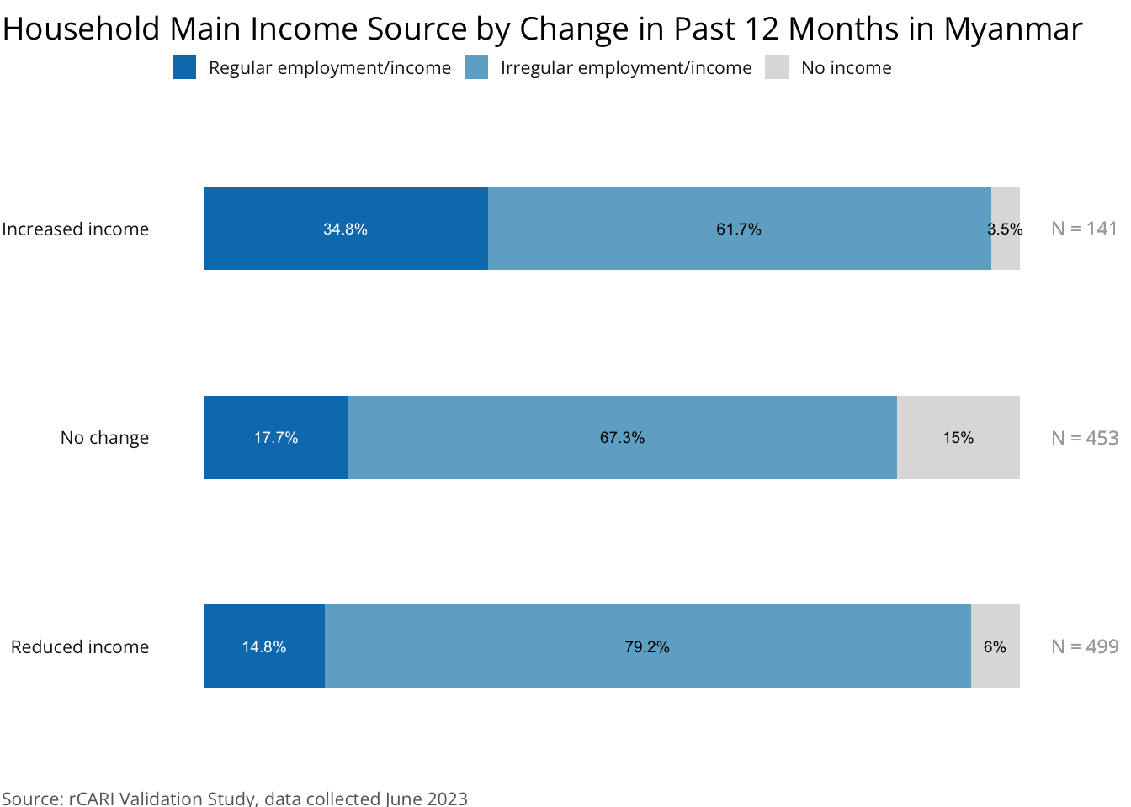
Before vs. After Recategorization - Myanmar
Before
After
Note: The other specify answers in income source variable (HHIncFirst_SRi) are fully cleaned in the aggregated 3pt category.

Slide 19
Next Steps
Expand the testing to other available dataset to enable larger evidence base for testing the indicator.
Possible reclassification of the income types based on the standardized income categorization of Lower-, Lower-middle-, Middle-, and High-income groups.
Sensitivity analysis of the individual income sources [HHIncFirst] based on the results obtained from the correlation and sensitivity analysis.

Slide 20
Thank You!

